Slide 1
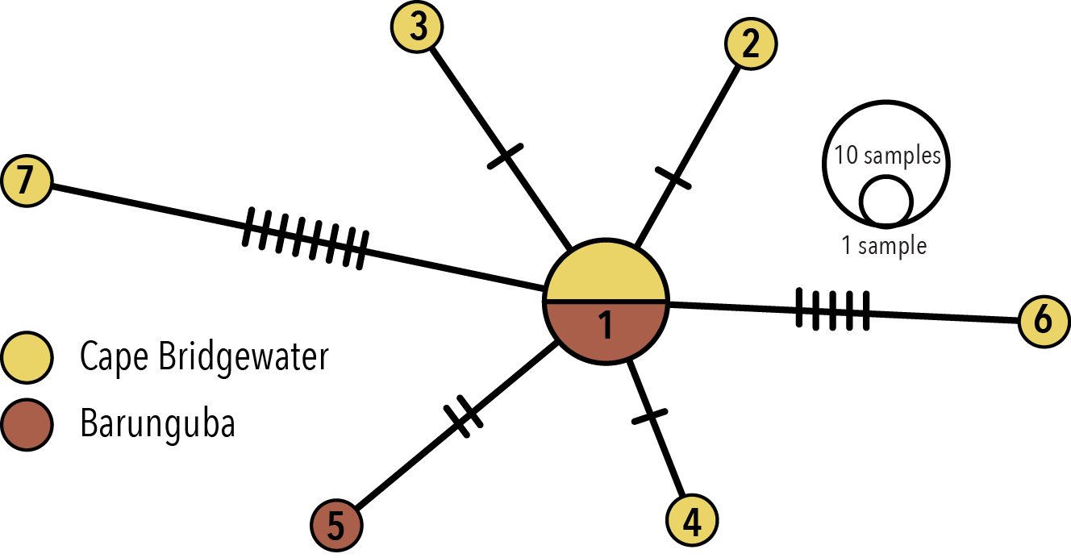
a)
b)
Number of mutations between haplotypes

